Slide 1
Blindsight: Navigation for the Blind
Team CARZ - Charlie Wong, Alec Yeasting, Riley Hunter, Zach Gherman

Slide 2
Introduction
Due to the size of the project, there were some questions we had to consider at the start of designing our project:
How will the system relay information to the user?
How will the system track the movements of the user?
How will the system process collision avoidance?
How do we envision the system to look?
How can we make this project achievable?

Slide 3
Audio In/Out
Soundpool
A method that allows the developers to play a sound byte on an action/event.
Allows for the creation of a collection of sounds that the system can pull from.
AudioManager
Another method that allows the developers to play a sound to the user.
Generally used for playing longer sound bytes (such as full length songs in .mp3 or .wav format).
TextToSpeech
A method which allows the developers to have customized audio messages based on textual outputs from the system.
SpeechRecognizer
A class which allows the developers to invoke an intent to process speech into text for further processing. Easy to use for yes/no questions and basic category based user search.

Slide 4
Positioning System
Development based research into different basis positioning systems:
Accelerometer based
WiFi based
Bluetooth based
Magnetometer based

Slide 5
Collision Detection
Our approach:
Use machine processing on standard camera data to estimate distances. Computer vision is beginning to be a mature field of computer science so we have no need to develop a system ourselves. We will try to use outside methods and libraries for this. OpenCV is our currently selected best candidate for doing this once we have a reliable stream of camera data.

Slide 6
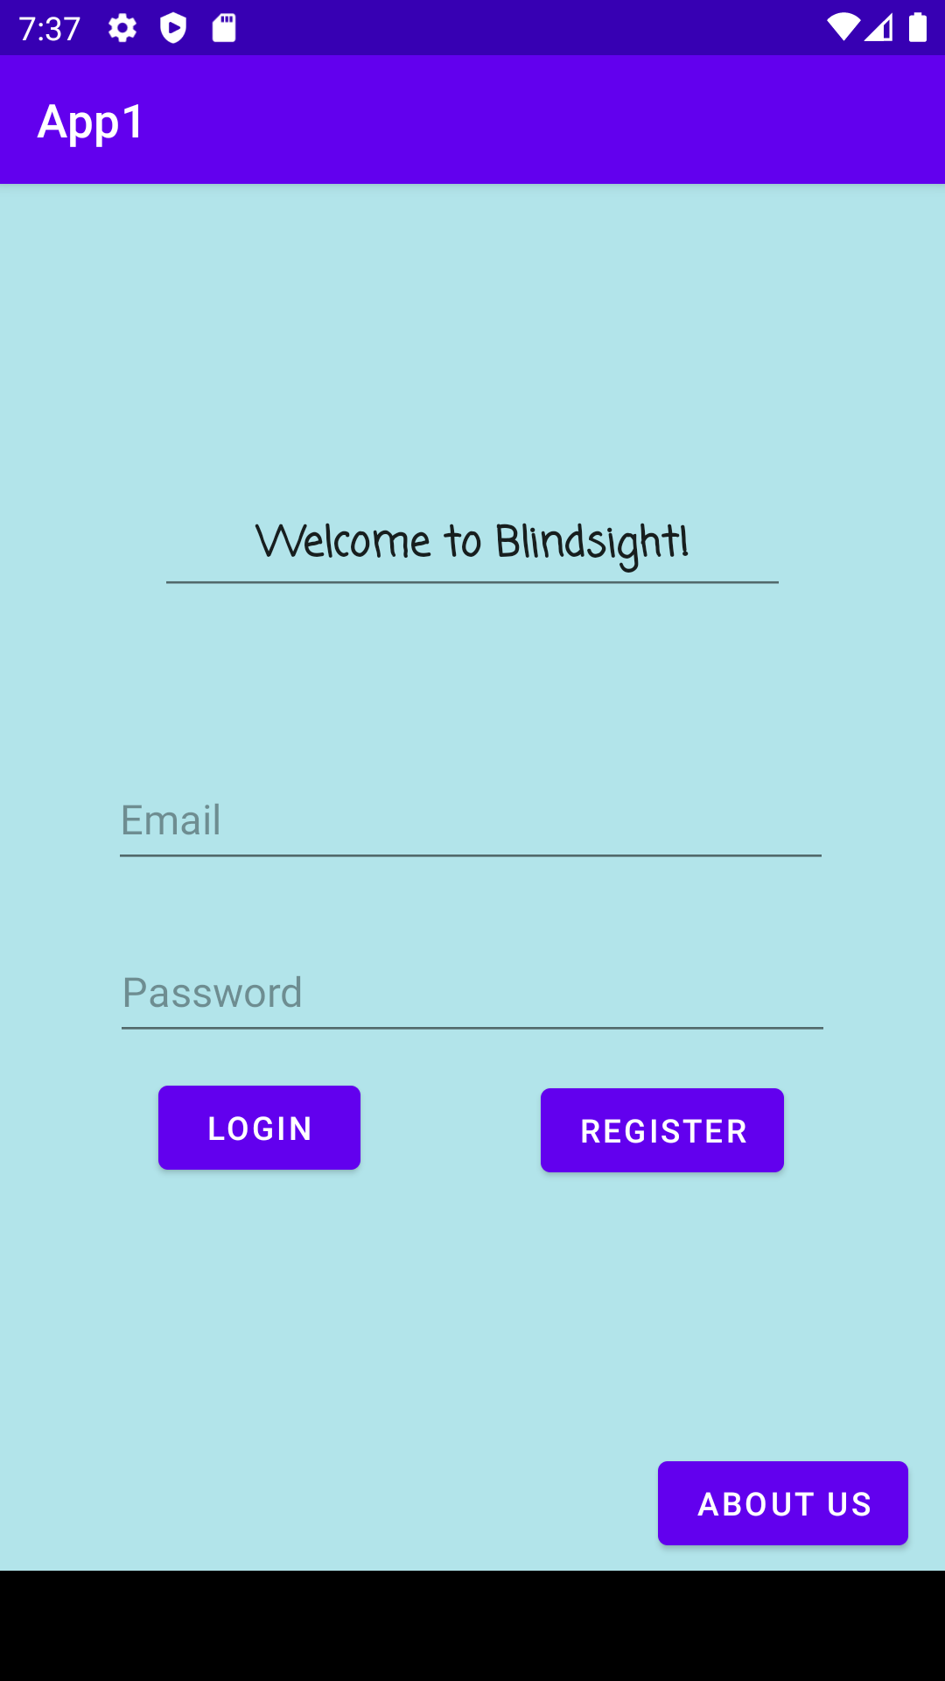
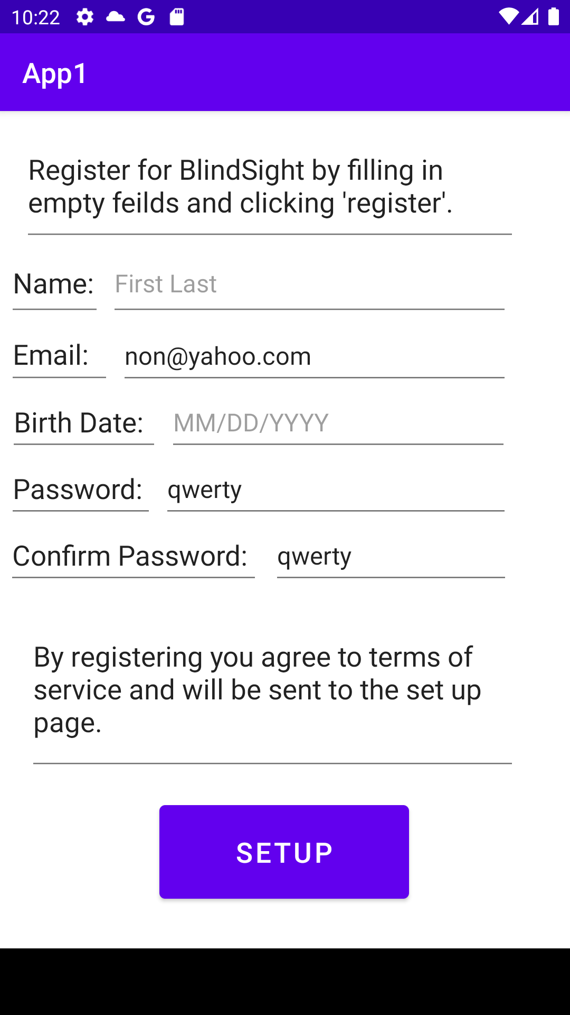
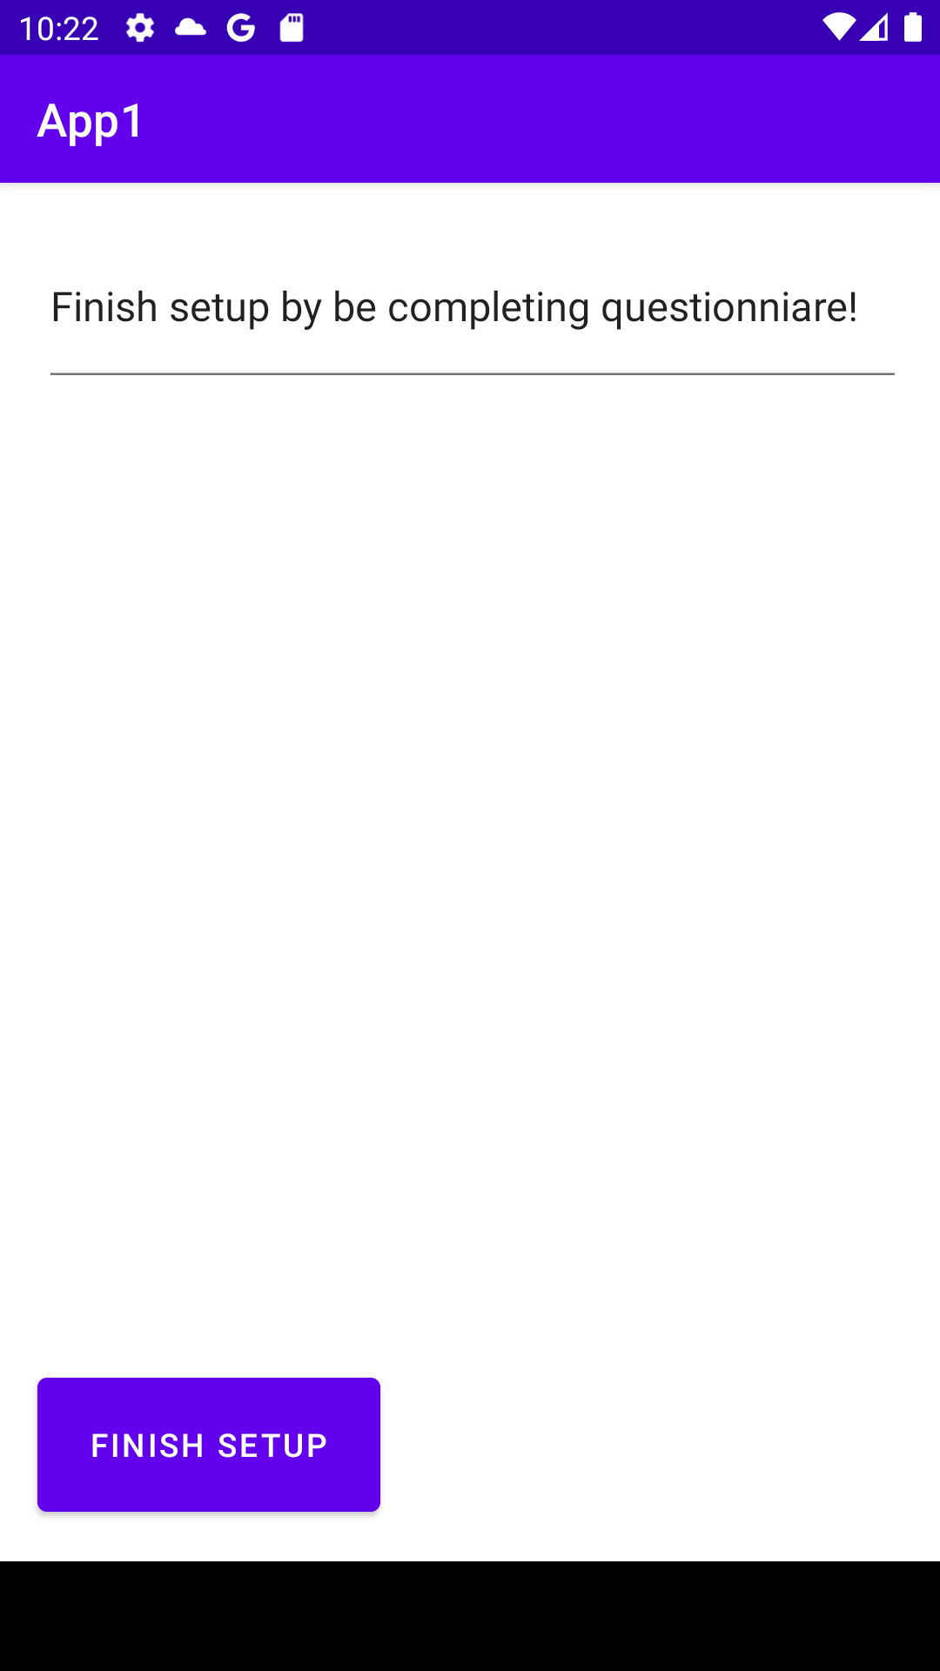
User Interface (Current Mockup)
Figure 3. Setup page (for now questionnaire is left blank).
Figure 1. Login Page - Local email/password (serverless).
Figure 2. Registration page (general account information).

Slide 7
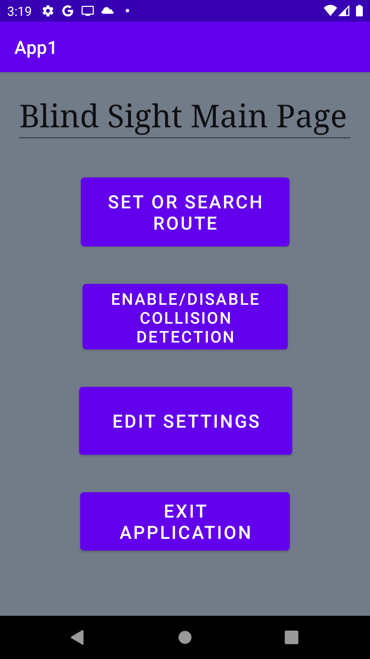
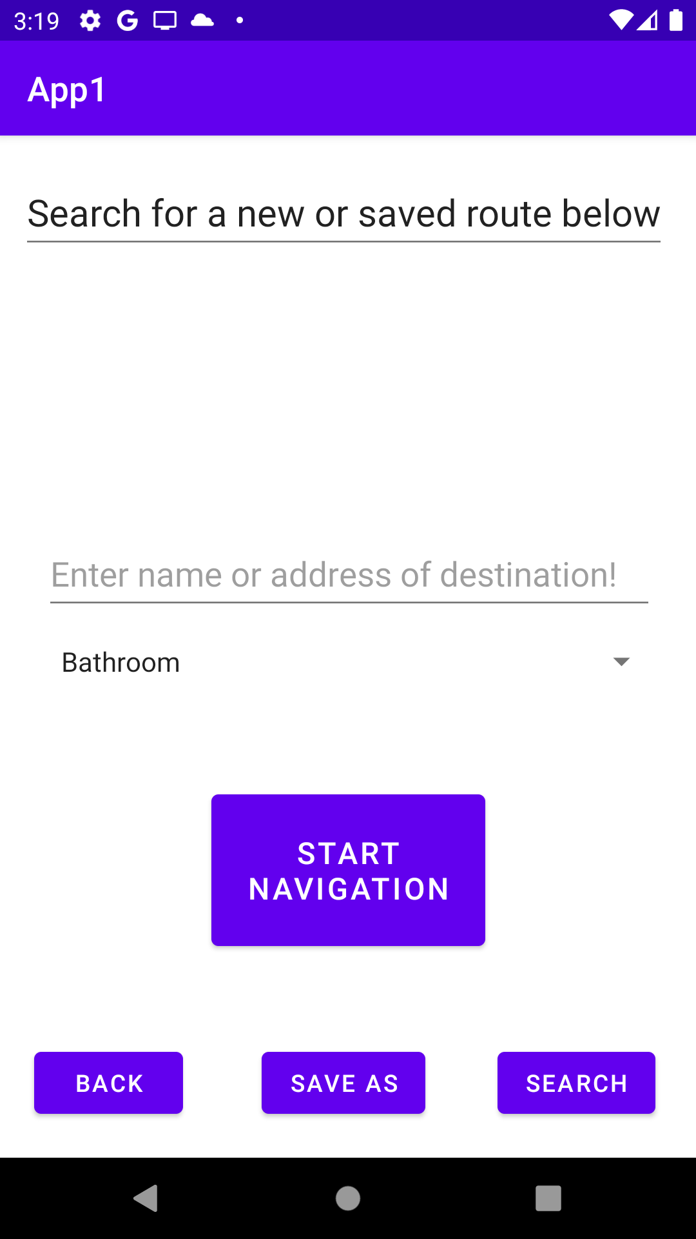
User Interface (Current Mockup)
Figure 4. (To the left) Main activity page where user selects the option needed.
Figure 5. (To the right) Set/search route for navigation page. Ability to search/save a particular destination/route. Contains start navigation button.

Slide 8
User Manual
Signing into your local (serverless) account
Registering and setting up your account
Navigating the main application
Account Settings

Slide 9
Project Definition
Goal : To help blind individuals navigate indoors and across multiple floors of a building.
Scope: Android Mobile Devices 5.0+ (Lollipop or later).
Objective(s): - To help blind individuals navigate indoors. - To help blind individuals avoid obstacles.
Limitations: Knowledge of Android Studio, DenseNet, Bluetooth positioning, Wifi positioning.

Slide 10
Project Definition (Continued)
Success Criteria:
Build a working prototype that utilizes at least one positioning system to achieve a reasonably accurate indoor navigation system in an arbitrary predefined environment.
Build a working prototype that utilizes a camera to accurately determine the position of at least one obstacle in the blind individual’s path.

Slide 11
Creeping Rate
What creeping rate can we handle?
Low. The scope of the project is big enough that we need a good plan for keeping creep at bay. All of us will already each need to individually learn a lot for the project to be realistically possible.

Slide 12
How we plan to combat Creep
Building small prototypes of key components.
Setting reasonable time frames for development and documentation creation/evolution.
Adherence to the documentations set forth by the team.
Treat our development as research, we need to be flexible enough to abandon a less feasible idea for a more feasible one to accomplish the project description.
TESTING TESTING TESTING!

